Slide 1
Fundamentals of Construction
PLTW Gateway
Green Architecture
Activity 1.8 Fundamentals of Construction

Slide 2
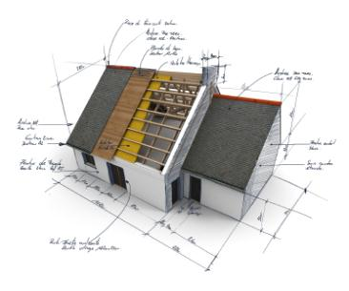
Fundamentals of Construction
What Is Construction?
Types of Building Classifications
Parts of a House
  Common Rooms
Systems in a House
  Plumbing
  Electrical
  Heating and Cooling
Wall Types
Common Roof Styles
Types of Architectural Plans

Slide 3
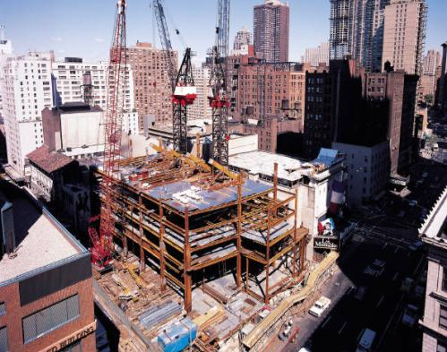
What Is Construction?
The process of building a structure that can be used for many functions.

Slide 4
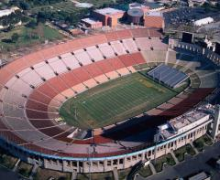
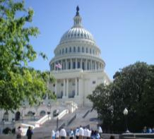
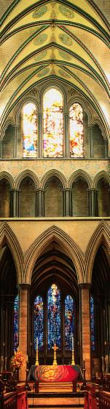
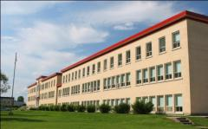
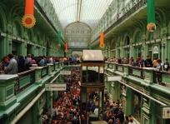
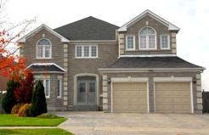
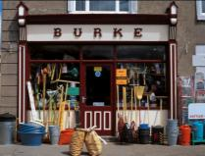
Types of Construction
Match the picture with the category.
Family
Community
State
Religious
Trade
Recreation
Education
1
2
7
3
4
5
6
Notes:
Types of Construction
Family: Residential, homes where people live
Community: YMCA, community centers, food banks, recreation halls, parks
State: Town hall, government buildings, state capitol building
Religious: Mosque, church, synagogue, any place of worship
Trade: Shopping, businesses, factories, production
Recreation: Sports centers, fields, hockey rink, arcades etc.
Education: Schools, colleges, library

Slide 5
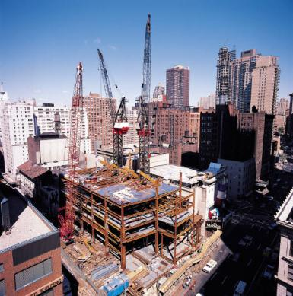
Commercial Construction
A building with more than 50 percent of its floor space used for commercial activities. Commercial buildings include stores, offices, schools, churches, gymnasiums, libraries, museums, hospitals, and warehouses.

Slide 6
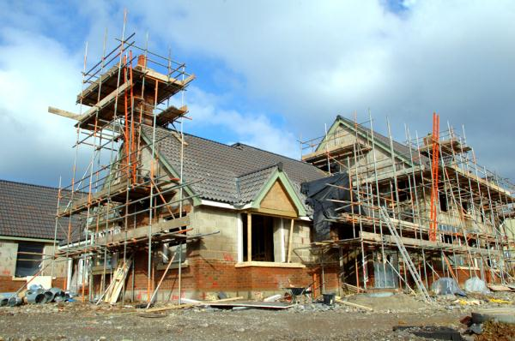
Residential Construction
The process of building a structure that serves as a dwelling or a home in which a person lives or resides.

Slide 7
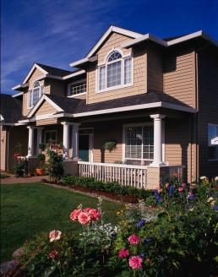
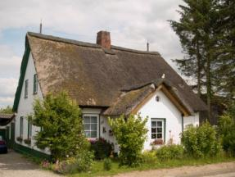
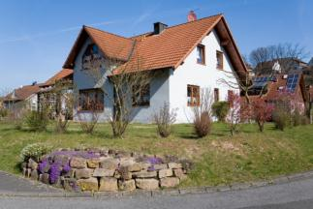
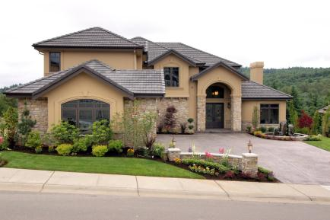

Single Family Home

Slide 8
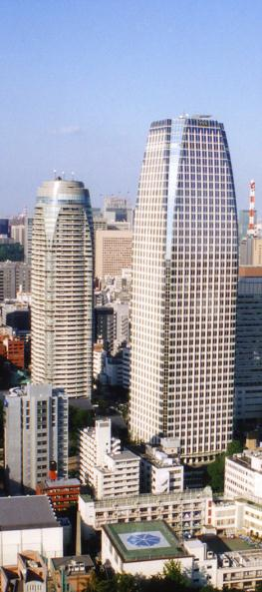
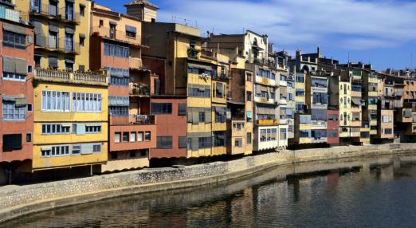
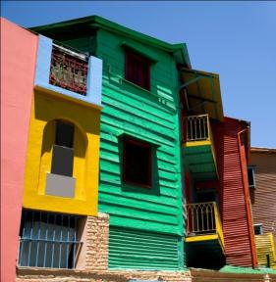
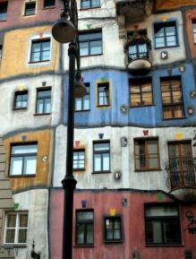
Single Family Apartments/Condos

Slide 9
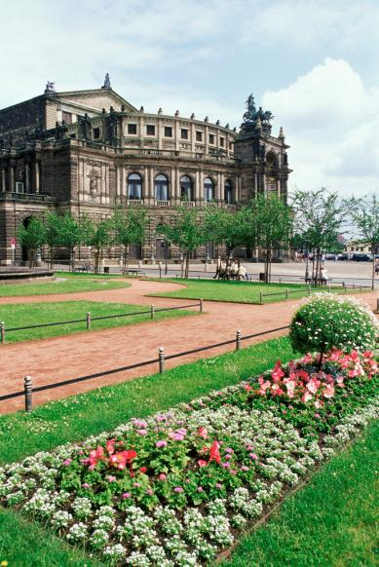
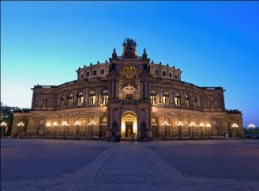
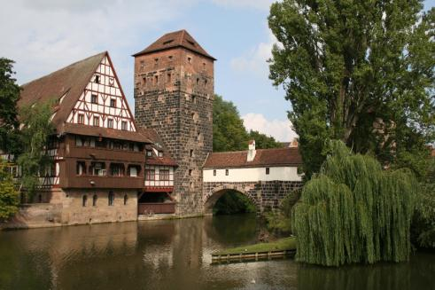
Large Mansions/Estates

Slide 10
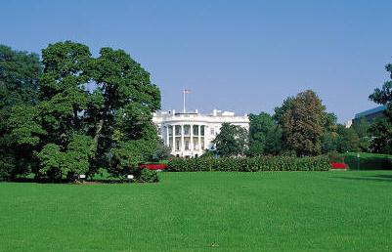
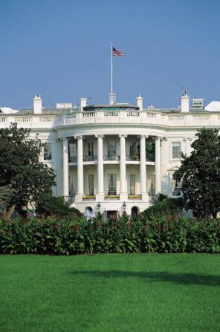
Specialty Home

Slide 11
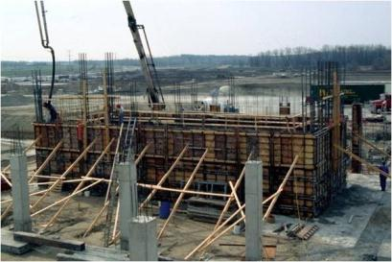
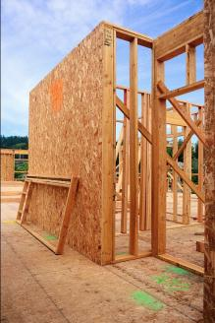
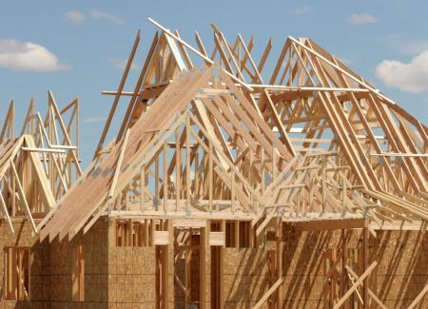
Parts of a House
Foundation
Floors
Walls
Systems
Roof

Slide 12

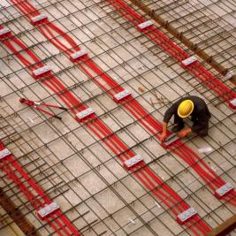
Foundation
Part of the structural system that transfers the load of a building to an area of the ground.
Floors
Floor Framing System – The primary way that horizontal loads are carried to the beams or columns; also provides lateral support for walls.

Slide 13
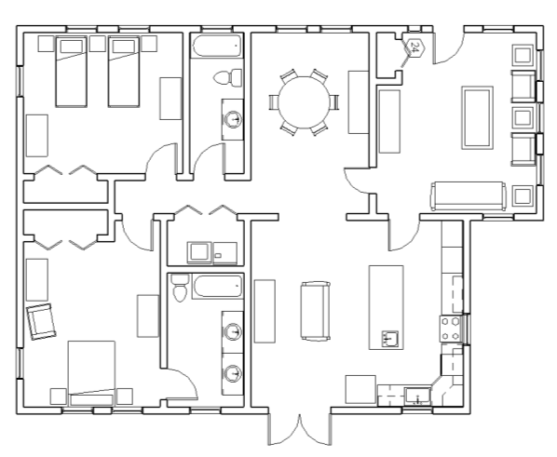
Wall Types
Load Bearing (Supporting)
Non-Load Bearing
(Dividing)
Notes:
Load Bearing Wall
Wall that carries a load in addition to its own weight. Ex: weight of the roof.
Non-Load Bearing Wall
Wall that carries no structural load and is used to divide spaces.

Slide 14
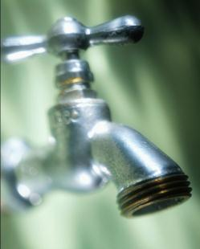
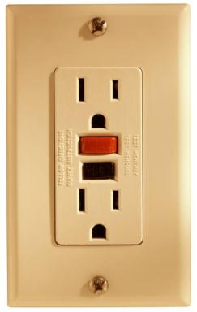

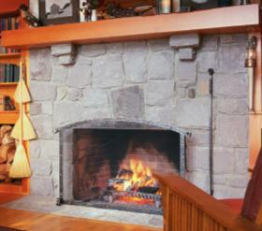
The Systems of a House
Plumbing
Electrical
Heating and Cooling
Roof
Notes:
Plumbing System
Refers to pipes and fixtures that use water and/or septic within a home.
Electrical System
Refers to wiring between light fixtures and switches, circuit loads, electrical devices, and equipment.
Heating and Cooling Systems
Refers to any system or mechanical device that provides either heating or cooling for a home. Ex: furnace, boilers, radiators, air conditioners, central air.
Roof System
Roofs protect buildings and occupants from wind, rain, cold, sun, heat, dust, etc.

Slide 15


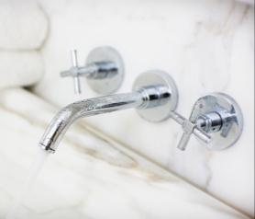
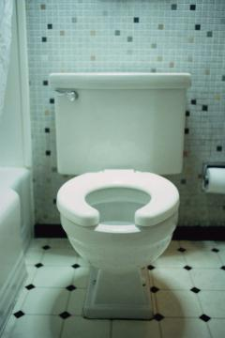
Types of Plumbing Systems
Sewer Management
Drinking and Waste Water
Notes:
Sewer system – Removes waste water from a home or commercial building to a waste treatment plant.
Septic system – Homes in rural areas have a septic tank and leach field to remove waste water.

Slide 16
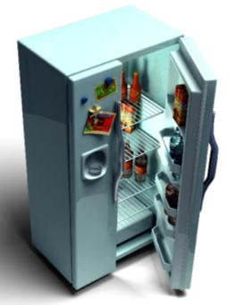

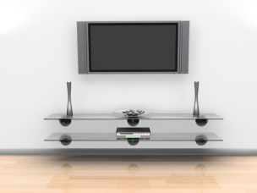
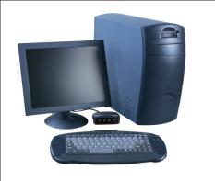
Types of Electrical Systems
Television
Cable/Internet
Appliances
Heat
Lighting

Slide 17
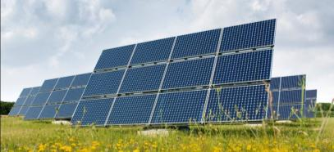

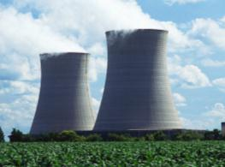


Energy Sources for Heating and Cooling Systems
Oil
Electric
Natural Gas
Coal
Nuclear
Sustainable
  Wind
  Solar
  Geothermal
  Hydroelectric
  Biomass

Slide 18
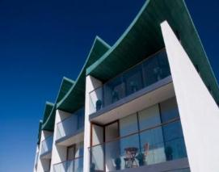
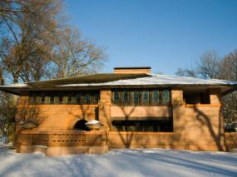
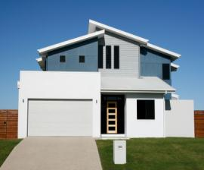
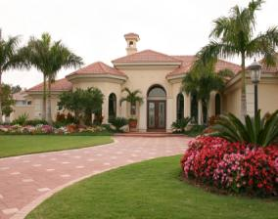
Roof Systems
Roofs protect buildings and occupants from wind, rain, cold, sun, heat, dust, etc.
Roofs come in many shapes.
Notes:
Roof styles can vary depending on the region in which the home is built.
Roof pitch or the slope of the roof is important in different regions.
Ex: A steep roof pitch can reduce snow load.
Different materials can also be used in different regions.
Ex: Metal roofs are popular in the North East United States.
Clay tiles are more popular in the South and Southwest.
Pitched roofs shed rainfall away from the structure.
Flat roofs require installation of drains to remove rain and snow melt from the structure.

Slide 19
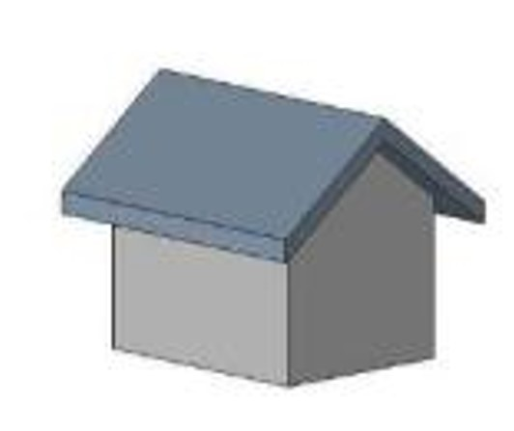
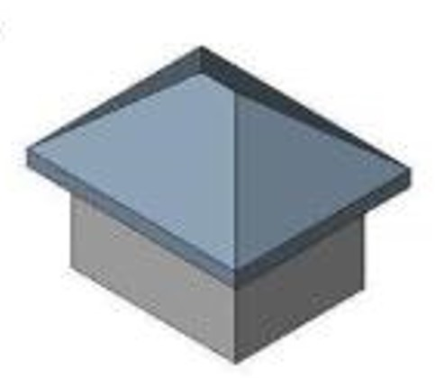
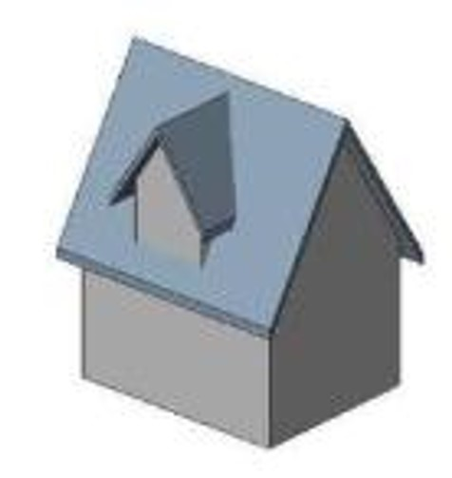
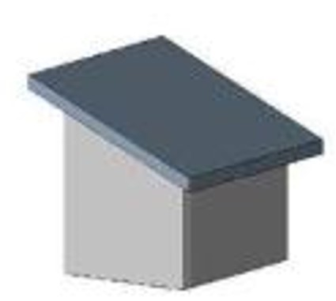
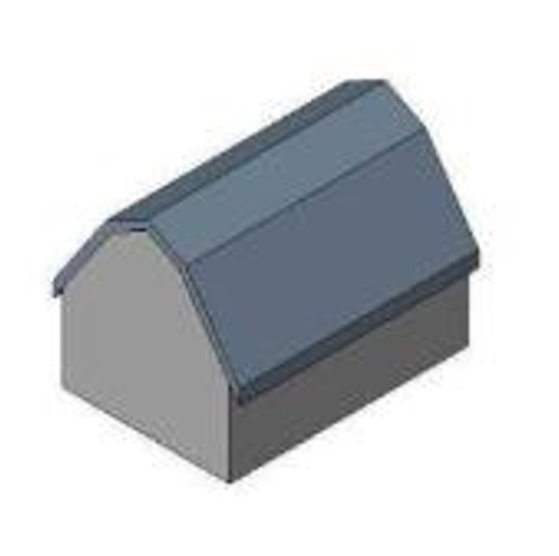
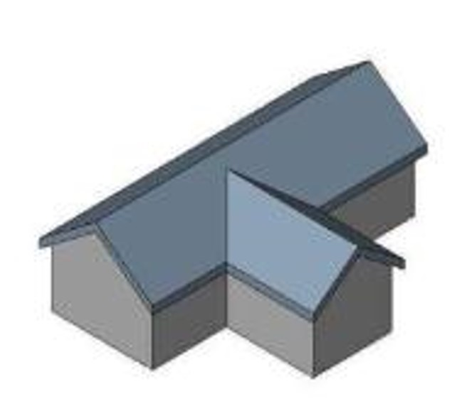
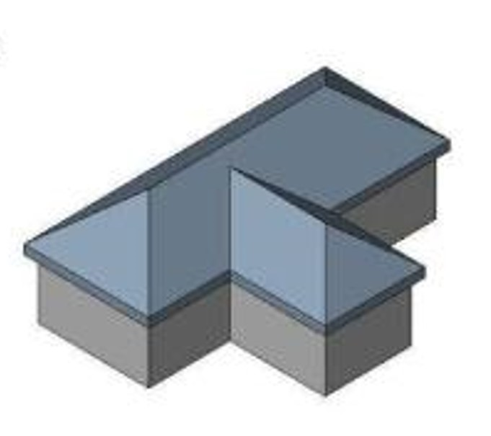

Common Roof Systems
Shed
Gable
Hip
Gable with Dormer
Flat
Gambrel
Gable & Valley
Hip & Valley

Slide 20

What Roof Types Do You See?
Notes:
Hip, flat, gable
Dormer off of the hip (right building)

Slide 21

Common Rooms

Slide 22

Areas of a Residential Home
Living areas
Sleeping areas
Service areas
Bathroom
Kitchen
Bedroom
Family
Room
Laundry
Room
Living Room
Dining Room
Bath-
room
Bedroom
Notes:
Notice . . . a bathroom that is connected to a bedroom is considered part of the sleeping area.
A bathroom in the living area of the house is considered part of the service area of the house.

Slide 23

In What Area Does Each Room Belong?
Living Room
Bathroom
Primary Bathroom
Bedroom
Kitchen
Dining Room
Family Room
Laundry Room
Living
Service
Sleeping
Sleeping
Service
Living
Living
Service

Slide 24
In What Area Does Each Room Belong?
Basement (not finished)
Basement (part finish)
Garage
Patio
Office
Library
Service
Living
Service
Living
Living
Living

Slide 25
How Is “Green” Energy Used in a House?
  Solar – Heating (air and water)
  Passive – Windows and skylights let in heat and light
  Active – Solar panels collect and convert sunlight into electricity or heat
  Geothermal – Uses the temperature of the earth to heat or cool the house
  Wind – Generates electricity
  Hydroelectric – Generates electricity

Slide 26

Types of Architecture Plans
Plot Plan
Designates the boundary lines of the property, location of the house, location of any other structures, roads, driveway, and sewer systems.

Slide 27

Types of Architecture Plans
Foundation Plan
Designates the outside walls and some interior structure walls of a house that support the above construction.

Slide 28

Types of Architecture Plans
Floor Plan
Shows the design and structure of the house, includes both load bearing and non-load bearing walls. Looks down on a house without the roof on. Includes details such as doors, windows, appliances, fixtures, and sometimes furniture.

Slide 29

Types of Architecture Plans
Elevations
Views of the structure or house from a given direction, usually north, south, east, and west.

Slide 30

Types of Architecture Plans
3-D Views
3-D depiction of the structure or house, usually to help in communicating the idea to the client or designer.

Slide 31

Types of Architecture Plans
Electrical, Mechanical, and Plumbing Systems
Shows the locations of the systems in the house (light switches, fixtures, outlets, heating ducts, sewer lines, etc.)

Slide 32

Types of Architecture Plans
Construction Details
Structural details that help the builders complete the house.

Slide 33
Image Resources
Microsoft, Inc. (2011). Clip art. Retrieved from http://office.microsoft.com/en-us/clipart/default.aspx

